Slide 1
Game: Guess a Number
Zoey Zhang

Slide 2
Game: Guess a Number
This project is a simple number guessing game where the user tries to guess a randomly generated number.
main( )
display_scores( )
read_history( )
get_player_name( )
repeat_game( )
store_name( )
Features:
Read history.txt file
Random number
User input
Too high / Too low
Loop until correct
Play again
Write in history.txt

Slide 3
Code:
def repeat_game():
x = []
again = 0
play_again = 'y' or 'Y'
while again != 1:
if play_again =='y' or play_again =='Y':
time = 1
number_range =list(range(1,101))
a = random.choice(number_range)
print(f'test: --{a}--') ########## test
user_number = int(input(f'#{time} Guess an integer number between 1 and 100: '))
while user_number != a:
if user_number < a:
#output guess is too low
print('Your guess is too low.')
elif user_number > a:
#output guess is too high
print('Your guess is too high.')
user_number = int(input(f'#{time+1} Gusee an integer number between 1 and 100: '))
time += 1
Key Concepts:
Random module
while loop
if - else
initialize again = 0, which starts the while loop
create a random number
for testing the result
deal with the incorrect numbers

Slide 4
Code:
initialize again = 0, which starts the while loop
if user_number == a:
print(f'Congratulations - You are correct!')
print(f'Number of guesses: {time}')
#write all of times which user guesses
x.append(time)
play_again = input('Would you like to play again(y/n)?: ')
#ask user if they want to play again
elif play_again == 'n' or play_again == 'N':
again = 1
else:
print('Not a vaild entry (Y/y or N/n)')
play_again = input('Would you like to play again (y/n)?: ')
#pick up the least time as a score
value = int(min(x))
#write this score to the Global variable list
game_history_guesses.append(value)
ask for playing again
stop the while loop
for the invalid input
get the best score for user

Slide 5
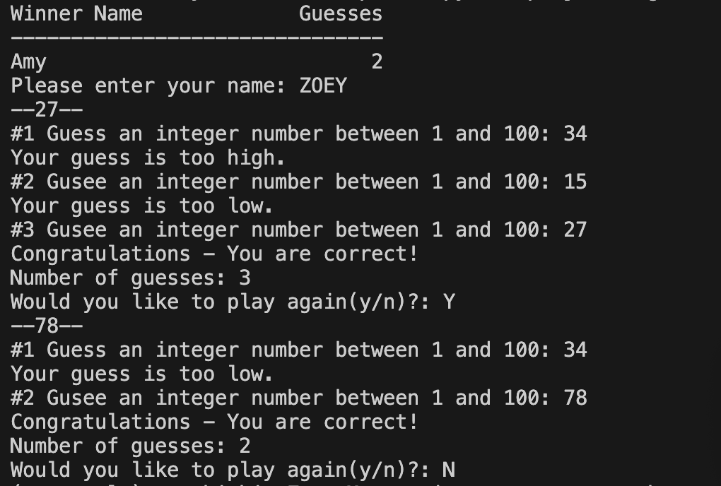
Run the Code:
for testing the result

Slide 6
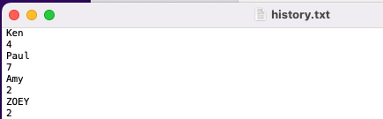

history.txt:
ZOEY will be the winner:
new record

